Slide 1

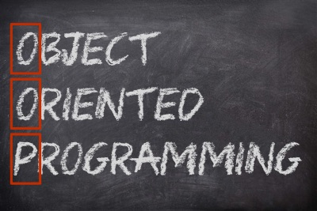

Абстрактни класове и полиморфизъм
ООП
Учителски екип
Обучение за ИТ кариера
https://it-kariera.mon.bg/e-learning/

Slide 2
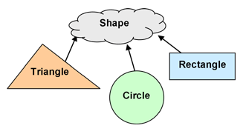
Абстрактни класове
2

Slide 3
Абстрактни класове
Абстрактните класове НЕ МОГАТ да бъдат инстанцирани
Абстрактният клас може да включва абстрактни методи, а може и да не включва такива.
Ако клас има поне един абстрактен метод, той трябва да бъде деклариран като абстрактен
За да използвате абстрактен клас, трябва да го наследите
public abstract class Shape {}
public class Circle : Shape {}
Shape shape = new Shape(); // Грешка при компилиране
Shape circle = new Circle(); // полиморфизъм

Slide 4
Елементи на абстрактния клас
Може да има полета
Public abstract class Shape
{
private Point startPoint;
protected Shape(Point startPoint) {
this.startPoint = startPoint;
}
public StartPoint { return this.startPoint; }
public abstract void Draw();
}
Може да има конструктор
Може да има методи с код в тях
Всеки абстрактен метод ТРЯБВА да се имплементира от подкласовете
Notes:
But they can be subclassed.

Slide 5
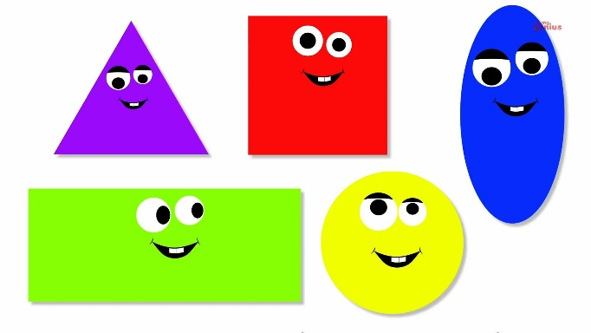
Задача: Фигури
Shape
-double perimeter
-double area
+CalculatePerimeter
+CalculateArea
Rectangle
Circle
-double height
-double width
-double height
-double width
+CalculatePerimeter
+CalculateArea
+CalculatePerimeter
+CalculateArea
Notes:
Extensibility / Polymorphism: New functionality may be easily plugged in without changing existing classes as long the new plug-in classes extend given base classes.
Reusability: For a set of similar applications a framework can be defined using a core set of classes that are to be extended by classes that fill in the application-dependent part.
Information Hiding: If a more general class using a simpler contract is sufficient, details from extending classes may be hidden to some of the client classes. This allows them to be more independent from possible changes and diminishes the load of contracts that must be understood by a reader of these client classes.
(c) 2006 National Academy for Software Development - http://academy.devbg.org*
5##

Slide 6
Задача: Фигури
public abstract class Shape
{
public abstract double CalculatePerimeter();
public abstract double CalculateArea();
public virtual string Draw()
{
return "Drawing ";
}
}
Notes:
Extensibility / Polymorphism: New functionality may be easily plugged in without changing existing classes as long the new plug-in classes extend given base classes.
Reusability: For a set of similar applications a framework can be defined using a core set of classes that are to be extended by classes that fill in the application-dependent part.
Information Hiding: If a more general class using a simpler contract is sufficient, details from extending classes may be hidden to some of the client classes. This allows them to be more independent from possible changes and diminishes the load of contracts that must be understood by a reader of these client classes.
(c) 2006 National Academy for Software Development - http://academy.devbg.org*
6##

Slide 7
Задача: Фигури (2)
public class Rectangle : Shape
{
//TODO: Добавете полета и конструктор
public override double CalculatePerimeter()
{ return this.sideA * 2 + this.sideB * 2; }
public override double CalculateArea()
{ return this.sideA * this.sideB; }
public sealed override string Draw()
{ return base.Draw() + "Rectangle"; }
}
Notes:
Extensibility / Polymorphism: New functionality may be easily plugged in without changing existing classes as long the new plug-in classes extend given base classes.
Reusability: For a set of similar applications a framework can be defined using a core set of classes that are to be extended by classes that fill in the application-dependent part.
Information Hiding: If a more general class using a simpler contract is sufficient, details from extending classes may be hidden to some of the client classes. This allows them to be more independent from possible changes and diminishes the load of contracts that must be understood by a reader of these client classes.
(c) 2006 National Academy for Software Development - http://academy.devbg.org*
7##

Slide 8
Solution: Shapes (3)
public class Circle : Shape
{
//TODO: Добавете полета и конструктор
public override double CalculatePerimeter()
{ return 2 * Math.PI * this.radius; }
public override double CalculateArea()
{ return Math.PI * this.radius * this.radius; }
public sealed override string Draw()
{ return base.Draw() + "Circle"; }
}
Notes:
Extensibility / Polymorphism: New functionality may be easily plugged in without changing existing classes as long the new plug-in classes extend given base classes.
Reusability: For a set of similar applications a framework can be defined using a core set of classes that are to be extended by classes that fill in the application-dependent part.
Information Hiding: If a more general class using a simpler contract is sufficient, details from extending classes may be hidden to some of the client classes. This allows them to be more independent from possible changes and diminishes the load of contracts that must be understood by a reader of these client classes.
(c) 2006 National Academy for Software Development - http://academy.devbg.org*
8##

Slide 9


Ключова дума – Sealed
Модификатора предотвратява други класове да наследяват съответния клас
public abstract class Shape {}
public sealed class Rectangle : Shape {}
public class Sqaure : Rectangle {}
//Грешка при компилиране

Slide 10
Ключова дума – Sealed
Позволява наследяване от класа и предотвратява презаписване на конкретен виртуален метод или свойства.
public class Rectangle : Shape
{
public sealed override double GetArea() {}
}
public class Sqaure : Rectangle
{
public override double GetArea() {}
// Compile time error
}

Slide 11

Какво научихме днес?
Абстрактни класове
Абстрактни методи
Употреба на sealed

Slide 12
Абстрактни класове и полиморфизъм
https://it-kariera.mon.bg/e-learning/

Slide 13

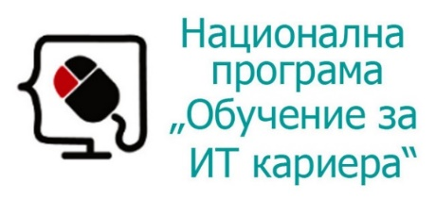


Министерство на образованието и науката (МОН)
Настоящият курс (презентации, примери, задачи, упражнения и др.) е разработен за нуждите на Национална програма "Обучение за ИТ кариера" на МОН за подготовка по професия "Приложен програмист"
Курсът е базиран на учебно съдържание и методика, предоставени от фондация "Софтуерен университет" и се разпространява под свободен лиценз CC-BY-NC-SA

